Slide 1
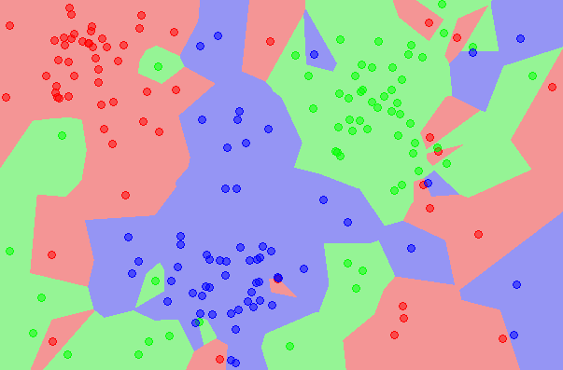
UNSUPERVISED LEARNING
Classification methods
k-NN

Slide 2
If two points are close enough, they will be in the same cluster.

Slide 3
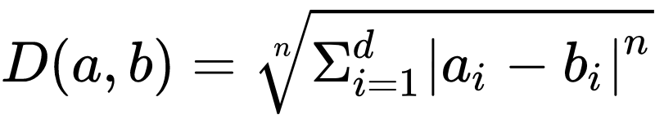

Distance Function.
Euclidean n Distance
Chebyshev Distance

Slide 4
K nearest neighbors
For each new point
Find K closest points in data
Find
That points will belong to that cluster.

Slide 5
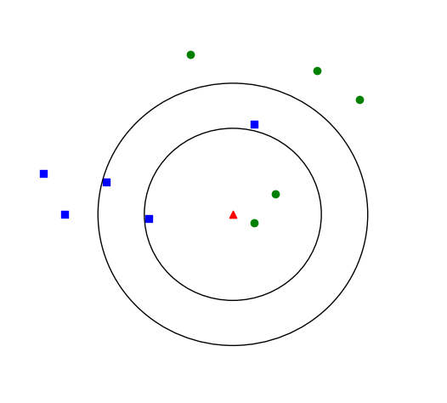

Slide 6
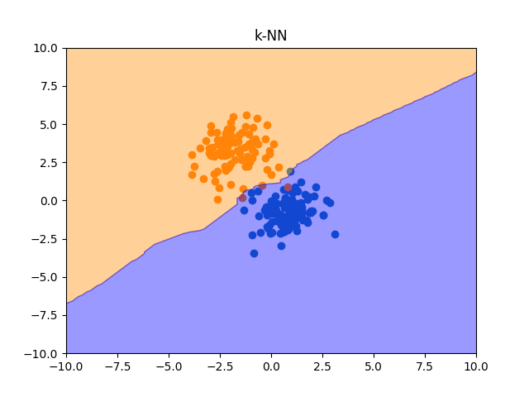
Homework

